Slide 1
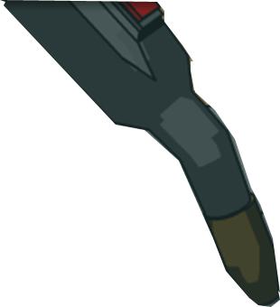
Module 1-Enterprise Welding Safety & Hazards
Manual Welder Training
1
Manual Welder Training
Notes:
Welcome to the Safety and Hazards training for Manual Welders at John Deere. This training has been designed for all employees globally who work at John Deere that may be producing welds on parts or products. The information for this module is recommendations taken from the JDV20.1 Welding Standards.
Note: This training is module one of six that you will be required to complete to become a manual welder at John Deere. In addition to this training, you will be provided with hands on weld training specific to your unit and certification will follow.
References:
American Welding Society (AWS). Retrieved on June 24, 2010 from http://www.aws.org/w/a/
Occupational Safety and Hazard Administration (OSHA). Retrieved on June 24, 2010 from http://www.osha.gov
Supplemental materials and photos were supplied by Lincoln Welding (Permission granted by Lincoln Welding for use of materials and photos included in their training modules used at John Deere).

Slide 2
E-Learning Help
Item | Tip
Course Credit | To get credit for this course, you will need to complete each screen, complete checkpoints and click the completion button at the end of the course.
Audio/Notes | This narrated presentation is best experienced with audio on. If your computer will not play the audio, click the “notes” tab to read the narrator’s script.
Navigation Buttons | After reading a slide, click the “next” button to continue.
Reference Material | The course refers to several documents you can view and print. Click the “attachments” button in the upper right corner to access them.
Notes
Next
Pause / Next
Previous
Attachments
Notes:
Please take a moment to review these e-learning tips.

Slide 3
Module Objectives
In this module you will learn:
The importance of wearing the proper equipment when welding
How to identify the possible risks in the welding process
The hazards that may be present when welding
The proper use of air and hand tools, hoists and other mechanical devices used in welding
How to locate safety information for welding and cutting processes
Notes:
Please take a moment to read the objectives for this course.

Slide 4

The American Welding Society
Safety Information in this course is in compliance with the American Welding Society and can be found in the attachments section of this course.
The purpose of the American Welding Society is to standardize weld processes and procedures in the industry.
American National Standard “Safety in Welding, Cutting and Allied Process” ANSI Z49.1-2005
Notes:
It is important to note that Safety information within this module can be found in the American National Standard “Safety in Welding, Cutting and Allied Process” ANSI Z49.1-2005. In addition, John Deere adheres to the regulations set by the United States Department of Labor known as the Occupational Safety & Health Administration (OSHA).
Please review the section called “Job Safety Analysis for Welding.” This document is located in the attachments section of this course.

Slide 5
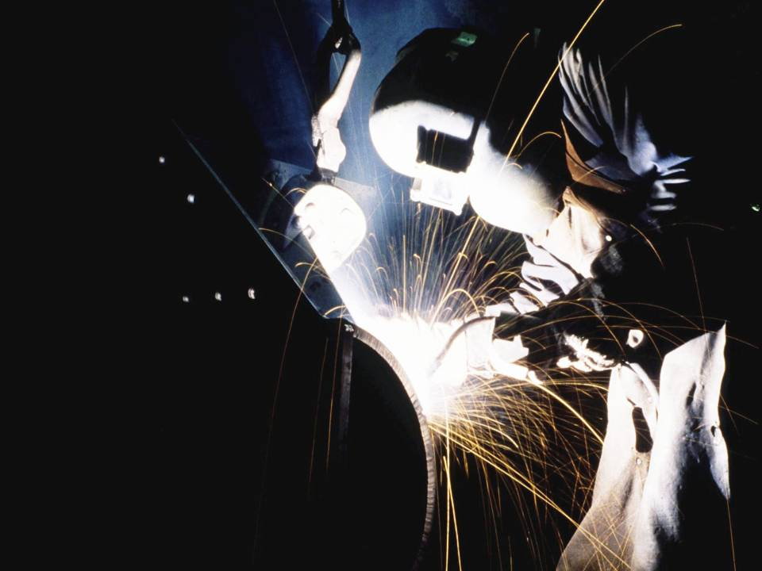
Module 1:
Personal
Safety Equipment
Notes:
John Deere takes safety very seriously. In this module, you will learn about required Personal Protective Equipment (PPE) for welding used at John Deere. Using PPE when welding is not an option, it is a requirement. At John Deere, we care about your safety and provide you with the needed equipment to keep you safe while welding.

Slide 6
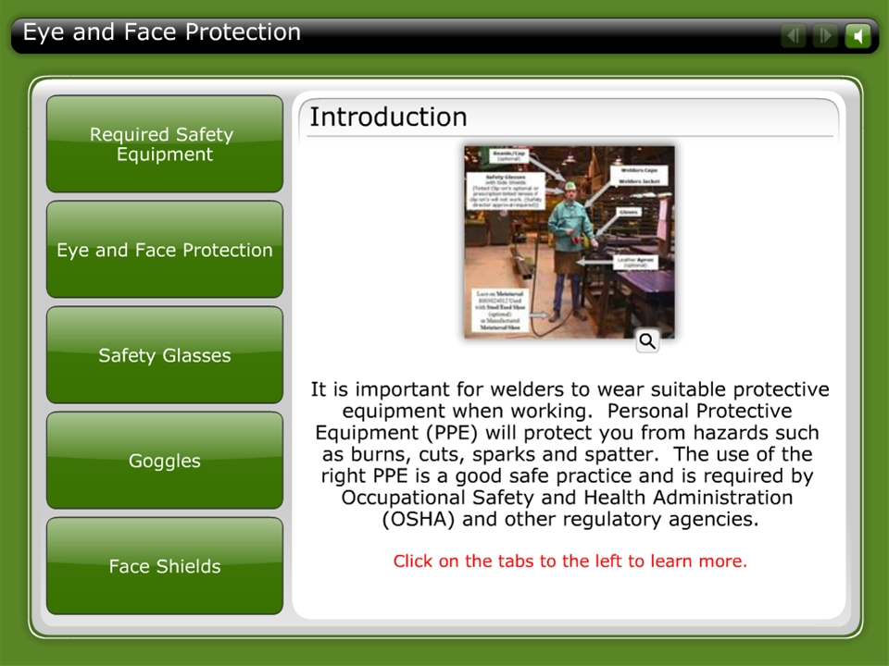



Eye and Face Protection

Slide 7
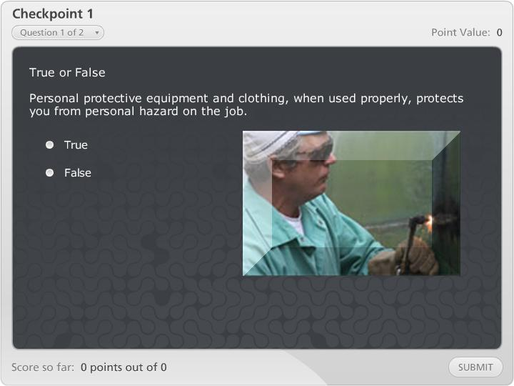

Checkpoint 1

Slide 8
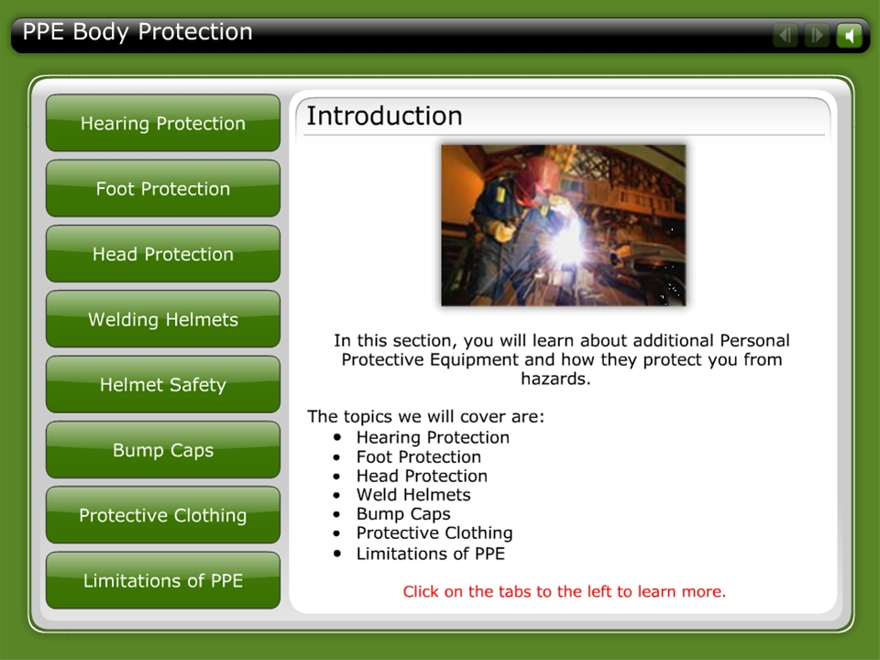
PPE Body Protection
Notes:
Reference:
Welding Photo on head protection tab. (2010). Retrieved from Lincoln Electric training (Powerpoint) called Welding Connects Your World (GMAW-Mig Welding). Retrieved from http://www.lincolnelectric.com

Slide 9

Checkpoint 2

Slide 10
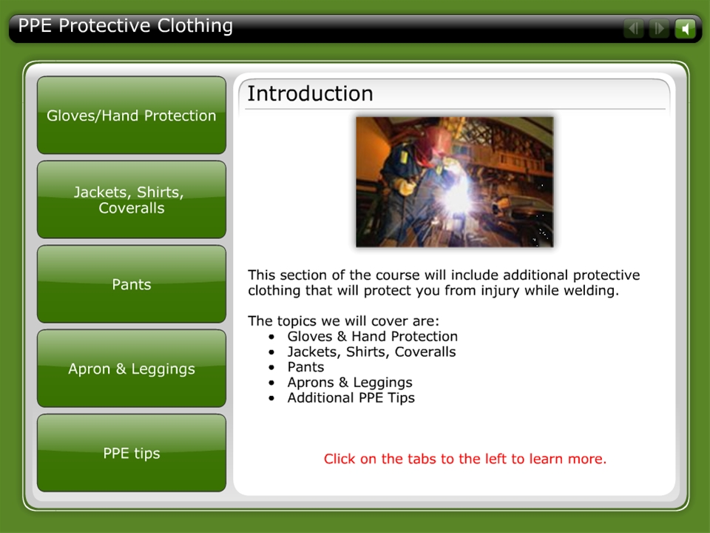
PPE Protective Clothing

Slide 11
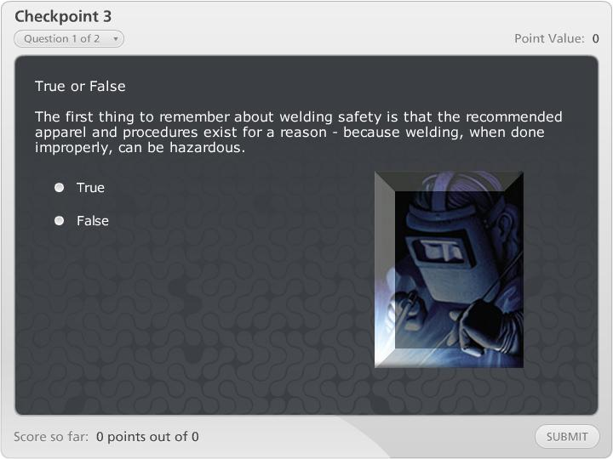
Checkpoint 3

Slide 12
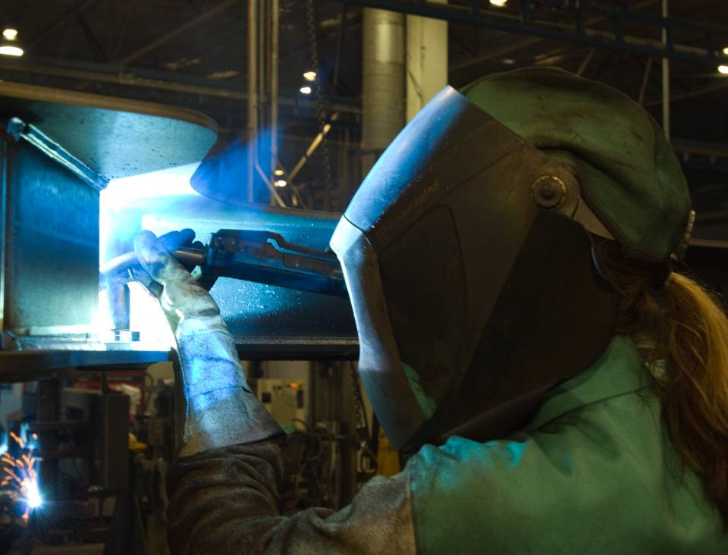
Welding Hazards
Notes:
Before welding in the production or maintenance environment, you need to be aware of welding hazards.

Slide 13
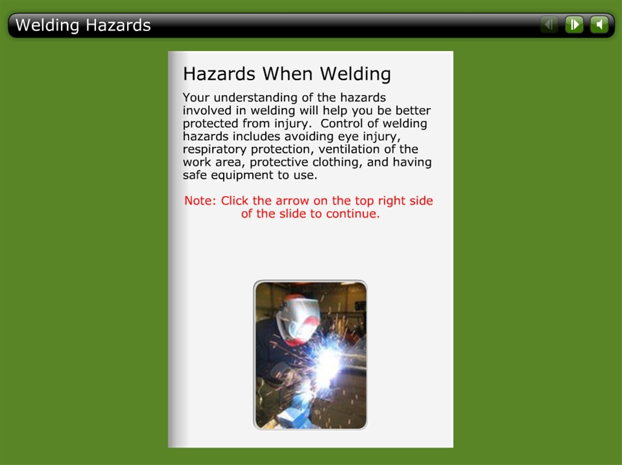
Welding Hazards
Notes:
Reference:
Avoiding Gases and Fumes Tab
Photo. (2010). Retrieved from http://www.lincolnelectric.com (Training module GMAW-Mig Welding)

Slide 14

Checkpoint 4

Slide 15

Pacemakers and Magnetic Fields
Notes:
There are other hazards, which must be considered when you are a welder in the factory to protect yourself from harm. People who have implanted medical devices, such as pacemakers, should not be welding.

Slide 16
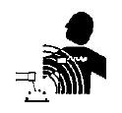
Magnetic Fields-Effects on Pacemakers
Pacemakers and Magnetic Fields
Pacemakers can be affected by electromagnetic fields.
Electric arc welding and cutting processes can produce electric and magnetic fields.
People with pacemakers should not go near welding or cutting operations without consulting their doctor.
Notes:
Pacemakers are devices, which are implanted in cardiac patients to ensure proper heart rhythm. Since these devices are electrical in operation, their ability to function can be affected by strong electromagnetic fields.
Electric arc welding and cutting processes produce intense electric and magnetic (electromagnetic) fields. Persons with a pacemaker should not go near welding or cutting operations until they have consulted with their doctor and have been cleared by a John Deere Medical doctor in his or her Medical Department.

Slide 17
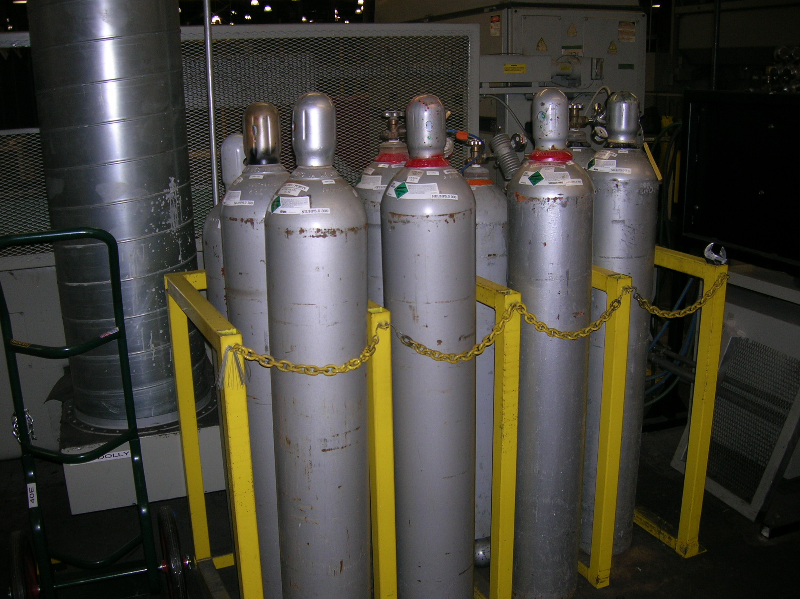
Cylinders
Notes:
Let’s learn about the handling, storage and safety of gas cylinders. Only trained and qualified personnel shall be allowed to use compressed and liquefied gases.

Slide 18
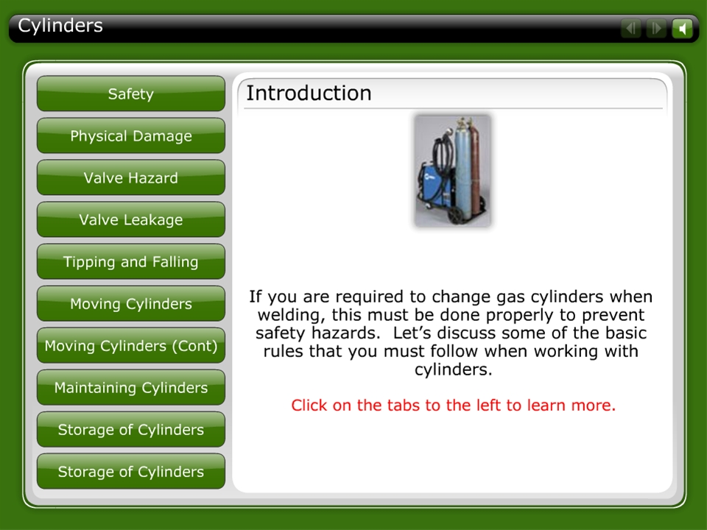
Cylinders

Slide 19

Checkpoint 5

Slide 20
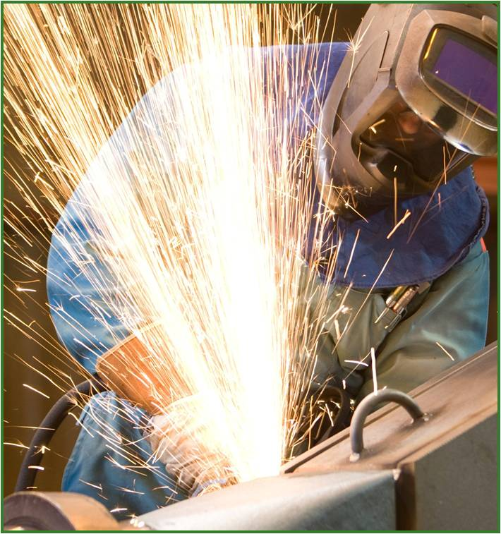
Welding and 5S
Notes:
5S is a method for organizing, cleaning, developing and sustaining a productive work place. The whole idea of 5S is to organize and clean up your workspaces in order to improve safety, efficiency, and effectiveness as well as to eliminate waste and frustration in your daily work.

Slide 21
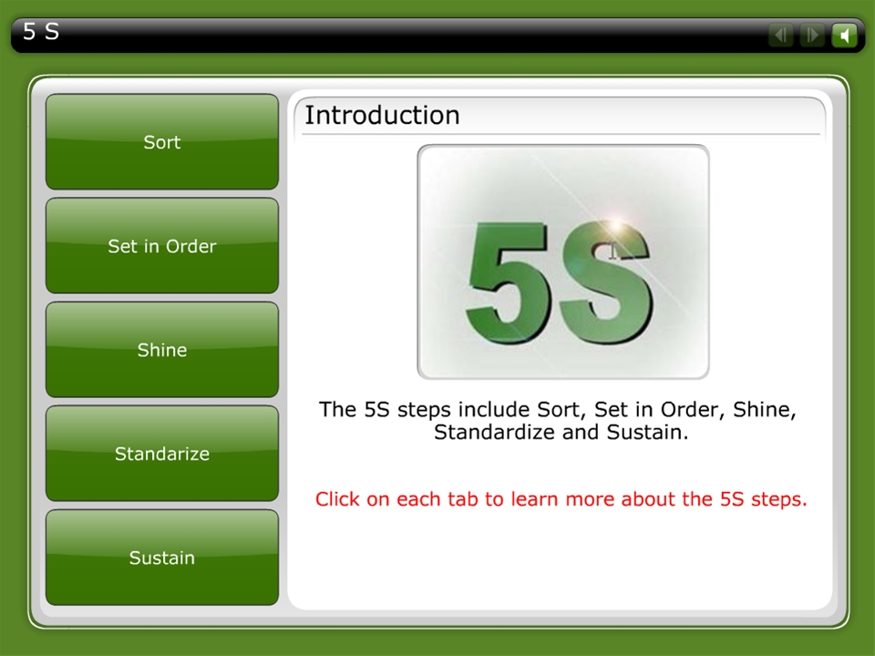
5 S

Slide 22
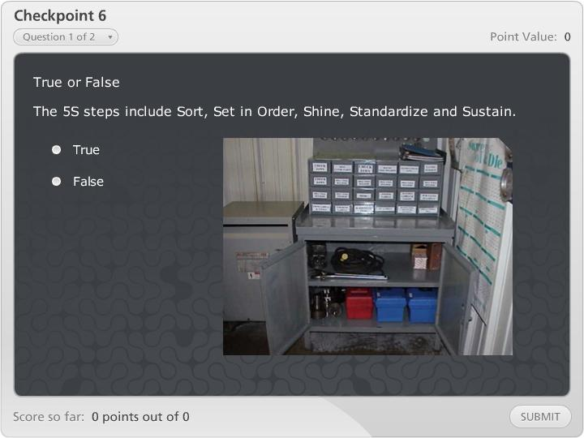
Checkpoint 6

Slide 23
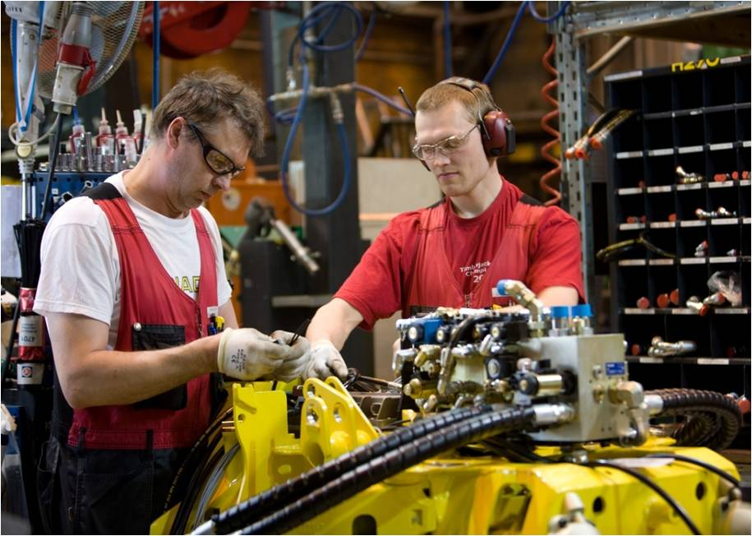
Hand Tool Safety
Use the right tool for the job
Use good quality tools
Use the tools as they were intended
Inspect tools
Maintain tools
Grip tools right
Do not overload or force tools
Rules when using hand tools:
Notes:
There are a few basic tips you can use when working with hand tools on the job.
Use the right tool for the job
Use good quality tools
Use them for the job they were intended to perform
Inspect tools before use
Never use a tool that is in poor or faulty condition
Keep all tools in good condition
Store tools properly when you are not using them
Keep a firm grip on tools to prevent them from slipping away and
Do not overload or force a tool beyond its capabilities.
By following these precautions, you can help prevent injuries and provide a better workplace for everyone. Remember, an ounce of prevention is worth a pound of cure!

Slide 24
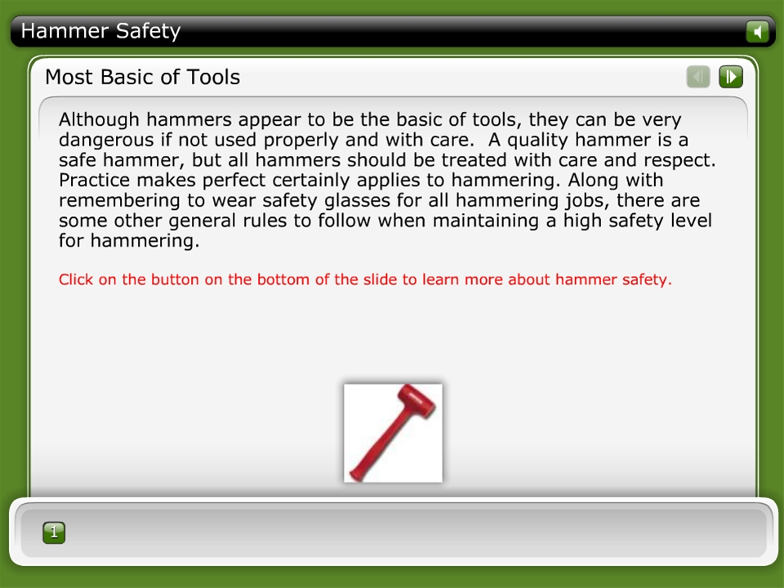
Hammer Safety

Slide 25
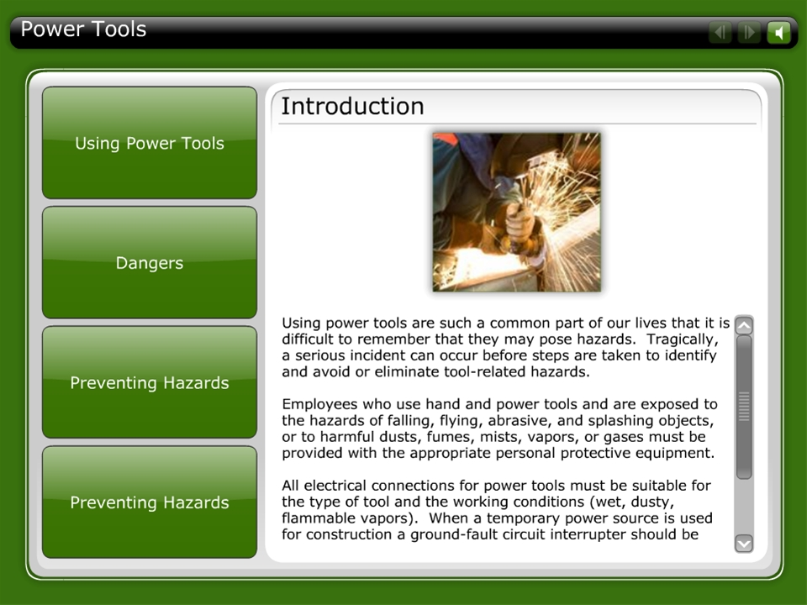
Power Tools

Slide 26
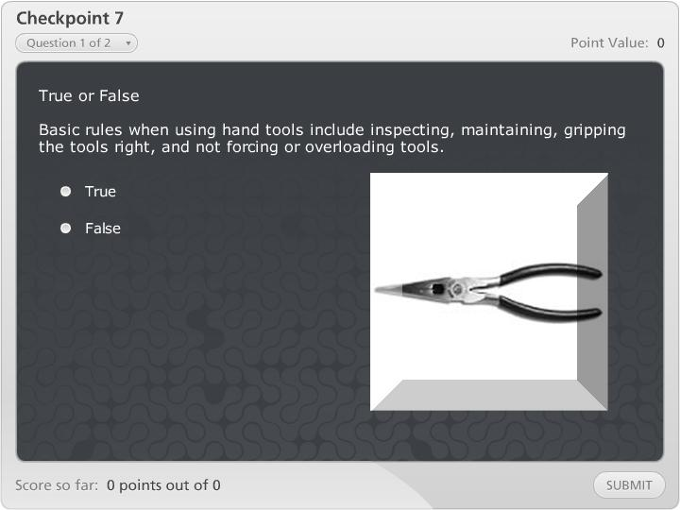
Checkpoint 7

Slide 27
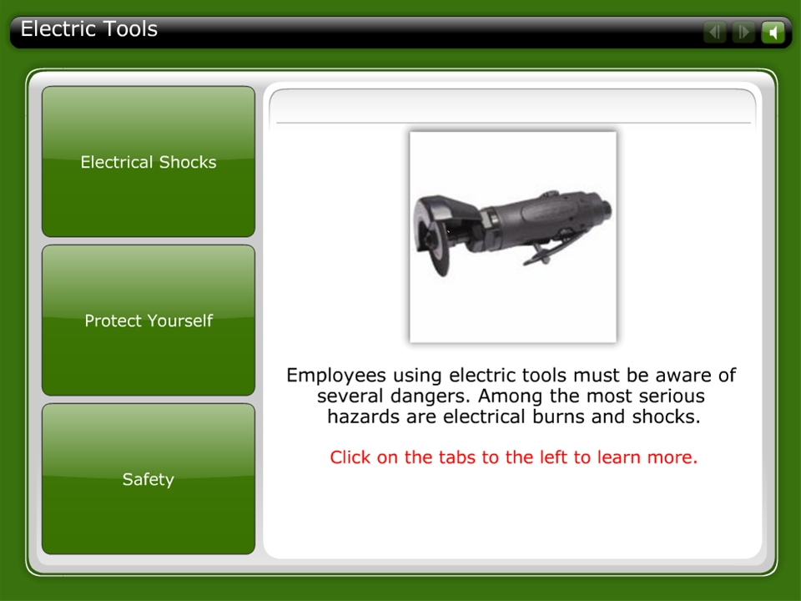
Electric Tools

Slide 28
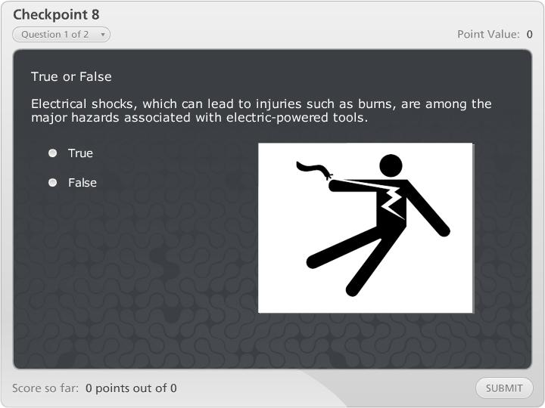
Checkpoint 8

Slide 29
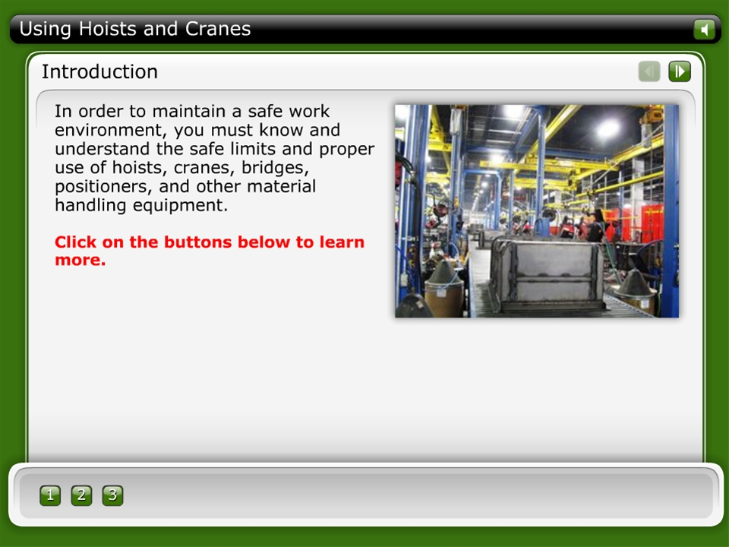
Using Hoists and Cranes

Slide 30
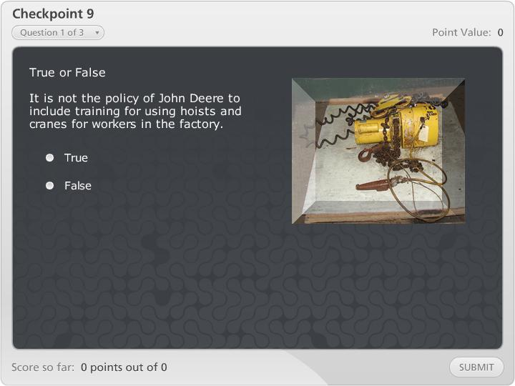
Checkpoint 9

Slide 31
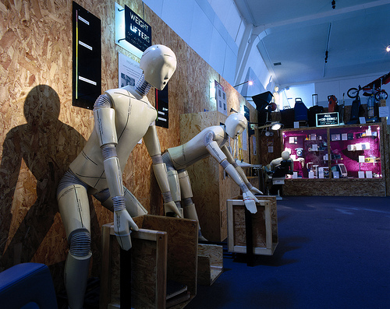
Ergonomics and Welding
31
Manual Welder Training
Notes:
Ergonomics is the science of arranging or designing things for efficient use. Ergonomics is also called Human Factors Engineering. It involves making the workplace fit the needs of workers. It does not try to make workers adjust to the workplace. When a workplace is designed properly, the worker feels comfortable. Quality and production increase. Everyone benefits.
Welding introduces many ergonomic challenges. Welding often requires awkward body positions. Body position and time are key factors in causing injuries. Ergonomics focuses on changing things (tools, equipment, facilities, etc.), not changing people.

Slide 32
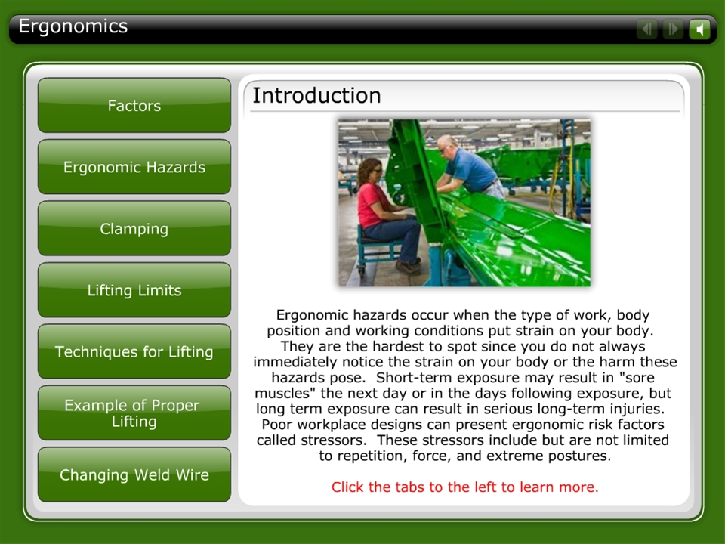
Ergonomics

Slide 33
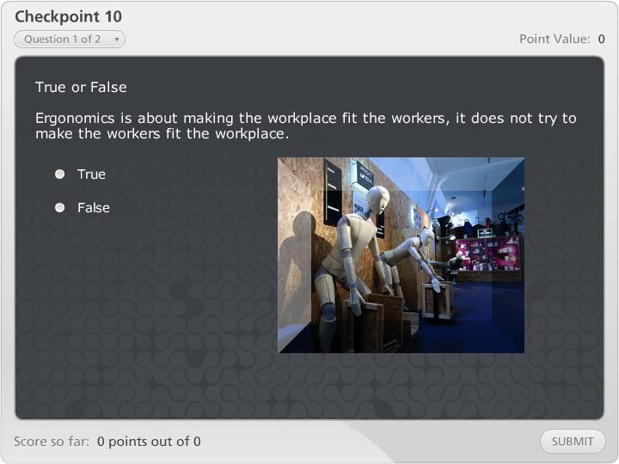
Checkpoint 10

Slide 34
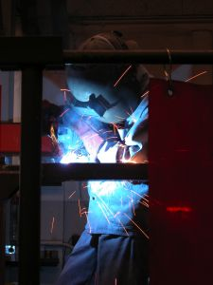
Summary Slide
Notes:
In this course, you have learned about using the correct protective clothing and equipment when welding. You have also learned about using hand tools, power tools, electric tools, hoists, bridges and cranes. In addition, you have learned the basics of ergonomics and proper lifting and handling of materials to prevent injury. It is important that you contact your supervisor or safety representative if you have additional questions.
This course is an overview and has not covered every tool or equipment you will be required to use when welding. If you encounter a situation where new tools are required for your job, ask your supervisor for assistance.
Note: For employees who are taking this course to become a welder at John Deere, this training will be supplemented with hands on training and then certification.

Slide 35

Acknowledgement Completion of the Course
Notes:
In order to receive credit for taking this course, please click on the button below. After clicking the button, click “Submit.”

